Slide 1
DAV6100: BnB Trend Insights
Group 1 (Section-2) :
Team Members:
Alluri Ratna Anvesh
Deepak Reddy Guda
Prem Chand Jala
Jaynish Shah
Sreyash Venkata
Arun Mathew
Sai Krishna Dadi

Slide 2
Agenda
Instructions:
Do not edit this slide
Overview
Project Requirements
Data Profile
Conceptual Architecture
Demo
Project Milestones & Timeline
Team Responsibilities
Challenges
Lessons Learned

Slide 3




Overview
The BnB Trend Insights system aids managers in setting competitive prices and enhancing guest satisfaction by analyzing varied neighborhood demands and room types. It integrates structured and unstructured data, utilizing AWS services like S3, Lambda, Cloud Watch, RDS, and Glue for efficient data management.
Data sources : CSV file and one from API call
Performed ETL
Data Visualization
(Tableau)

Slide 4
Problem statement
Airbnb wants to set the right prices and decide where to grow in New York City. They need to know how prices and customer reviews are related. This helps them understand what customers like and how it affects their booking choices. By looking at these trends over time, Airbnb can make smarter decisions about prices and where to expand in NYC.
Stakeholders : Airbnb, Customers, Hosts, Investors
Goal : Airbnb wants to make more money and keep customers happy in New York City. They're trying to figure out how prices and customer reviews are related. By doing this, they can make better decisions about where to grow and how much to charge

Slide 5
Project Requirements
Instructions:
You do not need to edit this slide. This is a summary of the project requirements
1. Design, Document, & Plan
3. Test the Solution
Develop a conceptual design architectures
Develop data flow diagrams and data models
Define analytics concepts with bus matrix
Define ETL Instructions
Define data attributes
A prototype is to be test
Break-testing and optimization of the database may be necessary (use of indexes)
Ensure that error-handling scenarios are considered
2. Develop and Build
4. Present and Deliver
Develop the warehouse solution using Amazon Web Services as the platform
Include two data structures:
Structured dataset
Semi/Unstructured dataset
Integrations:
Real-time
Data Visualization
Code Repository (GitHub)
Deliver an executive presentation
Demo the architectural components
Demo the visualizations in a data visualization platform like Tableau

Slide 6


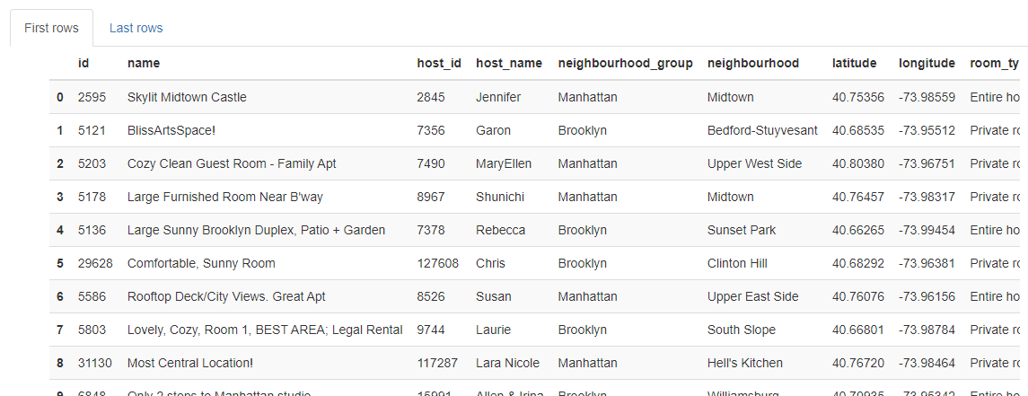
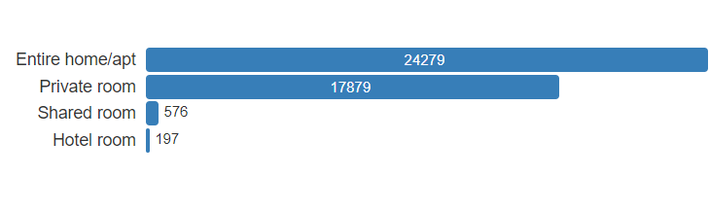
Data Profile: Final Dataset
Instructions:
Use this slide for every dataset you profile. You should summarize your datasets in these slides using basic statistics and information about the source and provenance of the data.
Dataset Summary
Source of Information
Number of Records
Frequency of updates
Data type and structure
Number of columns
Granularity
 | Csv (airbnb_dataset) API (Reverse geocoding api)
 | 42931
 | Every 30 Days
 | Numeric(10), Text(4), Categorical(2), Date(1)
 | 17
 | 1
Descriptive Statistics

Slide 7
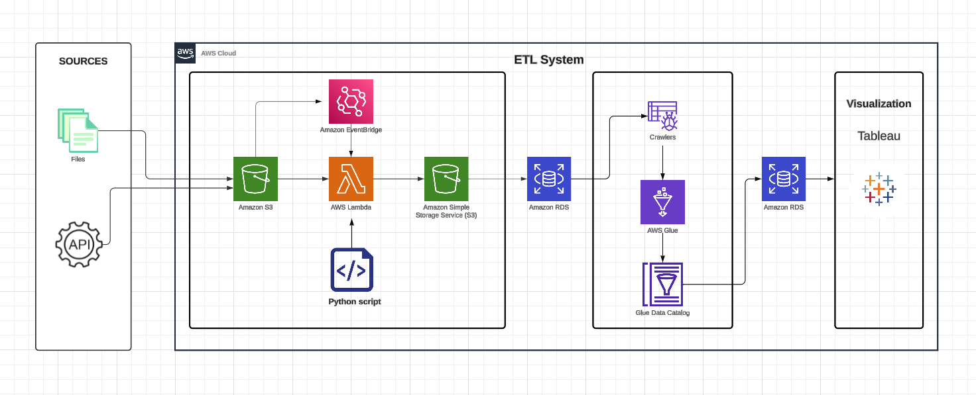
Conceptual Architecture
Instructions:
Use this slide to provide the conceptual architecture of your solution
In class we used Lucid Charts as an option to show the conceptual architecture, but I leave the decision to you

Slide 8









Instructions:
This is a placeholder. You do not need to edit, but you should plan to demo your solution at this point!
DEMO

Slide 9





Project Milestones & Timeline
(March 28)
(May 1)
(OLAP)
[Designed the dimension model]
Deliver & Present
Present final solution to class
Determine peer score
(Data extraction and preparation)
(OLTP)
[Created the tables and inserted the data by python script]
Visualization
[Using Tableau]
(March 18th)
(April 30)
Week 16

Slide 10
Team Responsibilities
TASK | MEMBERS
Data Gathering | Sreyash , Anvesh, Jaynish
Data Cleaning | Arun , Deepak , Prem
Architecture | Anvesh , Deepak
Data Transformation | Deepak , Anvesh
Data Visualization | Jaynish , Sai Krishna
Validation | Prem , Sai krishna , Sreyash

Slide 11

Assumptions
3
Data Consistency
When data stays the consistent, we trust it more
1
Data Availability
Having data ready helps make good decisions.
2
API Integration
Connecting other data easily makes them work together
4
Business Alignment Requirements
Making sure data is aligned with the business problem

Slide 12

Challenges
Instructions:
Describe the top 3 challenges of your project and why they were a challenge
We encountered daily API call restrictions, which resulted in a delay in data collection.
While executing Lambda_handler, we encountered an error related to the pandas Python library. We fixed this by creating a custom layer, which included a zip file containing pandas and its dependencies. This allowed us to continue with the next task.
In setting up and operating the AWS Glue Crawler, Job, and Data Catalog, we encountered several challenges . we are stilling working on that.

Slide 13

Lessons Learned
The following are the key lessons learned from the project.
Learned how to setup and fine-tuning of AWS Lambda triggers to boost automation and minimize redundant executions.
Learned how to manage AWS Glue ETL workflows, including setting up Crawlers and Jobs, and fixing any problems that came up.
Learned how to automate data transfers between S3 buckets using the AWS CLI and handle access permissions to ensure security and efficiency.
Gained experience in setting up data for Tableau visualizations, emphasizing the optimization of data structures and the design of impactful visual displays.

Slide 14
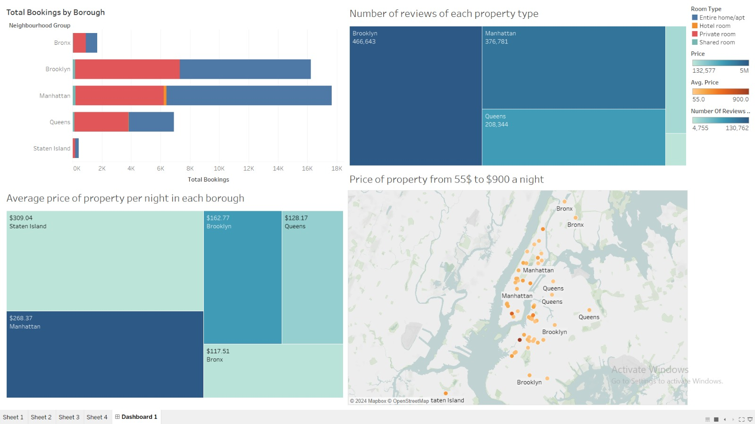

Slide 15
Thank You!

